Slide 1

Handling an 1,800 Percent Traffic Spike During Super Bowl XLVI
Jim Houska
Enterprise Architect
jhouska@cars.com
David Beran
Performance Engineer
dberan@cars.com

Slide 2

Agenda
Business Drivers
Legacy APM Challenges
Why dynaTrace?
Our Secret to APM Success
Super Bowl XLVI
2 Clicks to Fix
UEM
What’s Next?
Notes:
Visited by more than18M car shoppers each month, Cars.com is the leading online automotive destination- providing invaluable insight in to all aspects of automobile ownership. Cars.com helps consumers formulate opinions on what to buy, where to buy and how much to pay for a car.
Cars.com, unlike some of or direct competitors, is focused on the Consumer first and foremost
Or in-house editorial team is best of breed and produces industry leading content
from the “Cars.com Annual Best of Awards” often quoted in OEM specific car commercials such as Toyota to the
“the top 10 worst things you mechanic can tell you” which I unfortunately recently experienced first hand….having been told my car was overheating due to a bad head gasket –
With and inventory of over 3.2M new and used vehicles, over 17K dealer customers, and strong partnerships with every major OEM foreign and domestic – with Cars.com confidence truly comes standard.

Slide 3
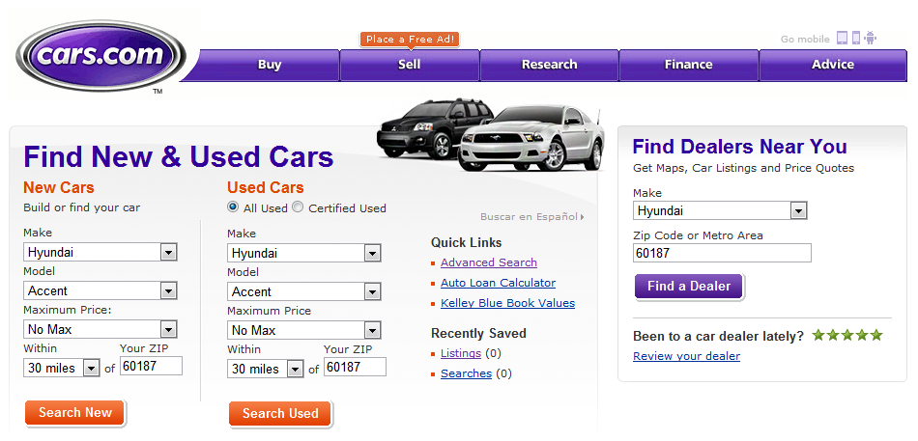
Confidence Comes Standard.
Leading online automotive destination
Insight into all aspects of automotive ownership
Car buyers are in control
Tools, research and listings
The Cars.com mission:
To make car buying and selling a great experience.
Notes:
Visited by more than18M car shoppers each month, Cars.com is the leading online automotive destination- providing invaluable insight in to all aspects of automobile ownership. Cars.com helps consumers formulate opinions on what to buy, where to buy and how much to pay for a car.
Cars.com, unlike some of or direct competitors, is focused on the Consumer first and foremost
Or in-house editorial team is best of breed and produces industry leading content
from the “Cars.com Annual Best of Awards” often quoted in OEM specific car commercials such as Toyota to the
“the top 10 worst things you mechanic can tell you” which I unfortunately recently experienced first hand….having been told my car was overheating due to a bad head gasket –
With and inventory of over 3.2M new and used vehicles, over 17K dealer customers, and strong partnerships with every major OEM foreign and domestic – with Cars.com confidence truly comes standard.

Slide 4
Cars.com - Fast Facts
JVMs | 600
Dealer Customers | 17,000
Vehicle Listings | 3,250,000
Unique Visitors / Month | 18,500,000
Unique Images | 40,000,000
Page Views / Month | 200,000,000
Search Engine Queries / Month | 785,000,000
Consumer Activities / Month | 5,400,000,000
Images Served / Month | 7,200,000,000
Kilobytes of storage ☺ | 536,000,000,000
Notes:
This slide show some quick stats related to the size/complexity of our environment.
<review 2 or 3 impressive stats>
- 785M search engine queries / month; tracking 5.4B consumer activities / and are serving 7.2B images monthly.
OK, so I cheated a bit on the last one to ensure everyone stays awake…..I needed a number larger than 7.2B ….. so I converted ½ Petabyte of storage to kilobytes ☺

Slide 5
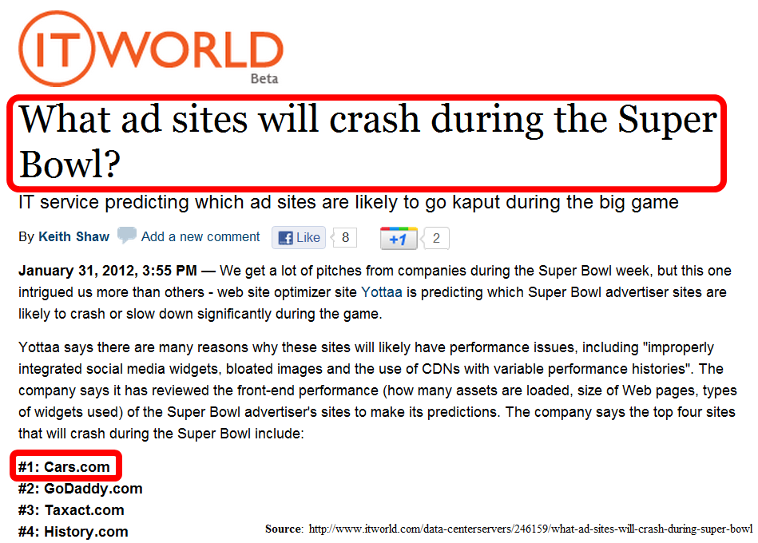
IT World / Yottaa Prediction…
Notes:
Leading up to the Super Bowl there was tremendous amount of pressure from the business to deliver a strong performance.
The potential impact in terms of marketing spend and brand image was huge. As our CTO said to me “Our credibility as an IT organization was one the line with this event”
If we deliver, the business has confidence in us very willing to continue to invest and support IT – we become a trusted partner
If we don’t…..we spend the rest of the year trying to recover our credibility as an organization
So a lot was at stake here, not only financially, but internally and externally.
To add fuel to the fire, a week before the game…..It World in conjunction with the web performance optimization company “Yottaa” predicted Cars.com as the number #1 site likely to crash during the Super Bowl.
I am very proud to say the results were fantastic…..Dave will take you into in more detail later in the presentation.

Slide 6
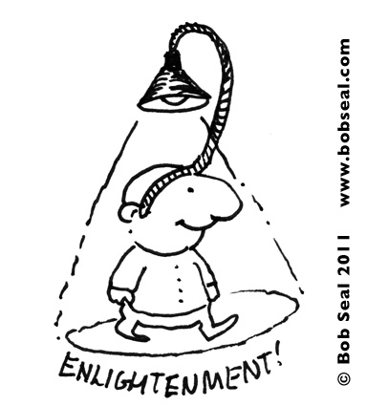
Our Journey to APM Enlightenment
Notes:
I want to quickly take you through our Journey from Legacy APM (complete frustration) to APM 2.0 or Next Generation continuous real-time APM (Happiness)

Slide 7
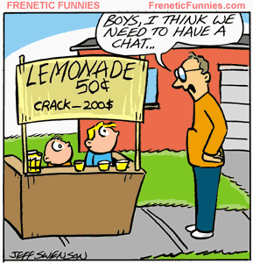
Business Drivers
Demanding more from IT
Agile-centric transformation
Rapid Growth
Exploding complexity
Desire for insight
Improved time-to-market
Poor performance = Lost $ or Job?
Notes:
Business pressures are driving IT to move faster than ever! The expectations form the business are becoming so high that in some cases they will avoid IT all together if they suspect it will slow them down–
Agile-centric transformation - In 2011 Cars.com went though an Agile transformation with the goal of becoming more “product-centric” and accelerating time to market of end-user driven features/functionality. This drove high rates of change into our production environments such as we have never seen before. We went from ~45 releases per year to over 220 releases per year - 12 dedicated product teams releasing into production as frequent as over other week. This was the real tipping point at which we realized we were going to sink or swim and needed a new APM strategy.
Rapid Growth – We are going through a period of tremendous growth
We have seen consistent, year over year growth over the last 8 years across all key business metrics including - sight traffic, network-wide revenue, operating income and of course employees to support that.
Our IT staff has tripled in the last 2.5 years and is still growing.
And we’re hiring!
Increasing application complexity requires a fresh approach what is truly a new set of problems
That’s why NG tools such as Dynatrace are uniquely positioned to deliver value because the were designed from the ground up to solve the challenges of today’s modern applications.
Migration to highly distributed, service-based, virtualized, and cloud infrastructures make this a much more difficult task than in the past.
Desire for insight
Our Product & IT Leadership were asking for deeper insight into the health and performance of our critical business applications. Being and online media company, our products are delivered to market via our applications. Any issues with performance or availability can impact revenue.
Improved time-to-market
Nothing (covered in agile above)
Poor Performance -
A 500ms increase in response time has a significant impact our business in the form of Lost ad-impressions, leads, brand damage and site abandonment.

Slide 8
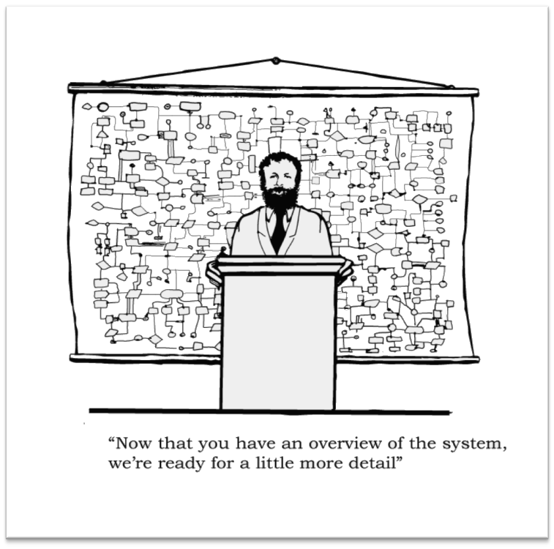
Application architectures are rapidly evolving.
Is your APM solution keeping pace?
“Now that you have an overview of the system, we’re ready for a little more detail.”
http://En.wikipedia.org/wiki/File:ArchitectureCartoon.png
Notes:
APM is fast becoming a critical IT discipline
and is no longer the ugly-haired stepchild back in the corner
A recent survey of IT executives by research firm “Quo Circa” found that 82 percent of CIOs expect their business customers and end-users to demand better performance, faster page loads, checkouts, etc.-from their websites and applications in 2012. And 43 percent of CIOs are not confident that they will be able to deliver.

Slide 9

Legacy APM Challenges
Lagging YEARS behind
Overhead and Instability
Need to know “what to look for”
Infrastructure component-centric
Intensive care and feeding
Rigid configurations
Specialized skill set
http://cheezburger.com/2689476608
Notes:
What were some of the challenges we faced in terms of legacy APM
We tried to make it work, we invested significant effort to try and get value out of it, but when it came down to it our Legacy APM solution could not keep up with the pace of our business.
Keep in mind theses are solutions for the most part, you could say they have evolved, but for the most part that were originally designed in the late 90s when applications were based on relatively simple 3 tier architectures (web, app DB) and as we know
Application architectures have evolved so rapidly, legacy APM solutions just can’t keep pace.
Looking at it in terms of features, functionality usability simplicity…..in my opinion these solutions are lagging years behind
We experienced first hand on several occasions “APM” tool-induced overhead and stability issues
Legacy tools require you to know “what to look for” vs. surfacing potential issues
Infrastructure component centric monitoring vs. the concept of a business transactions a experienced by the end-user
These products are extremely complex and difficult to install, configure, deploy and integrate.
And we were dependent on high-cost consulting resources and in-house “experts” of which we had none

Slide 10
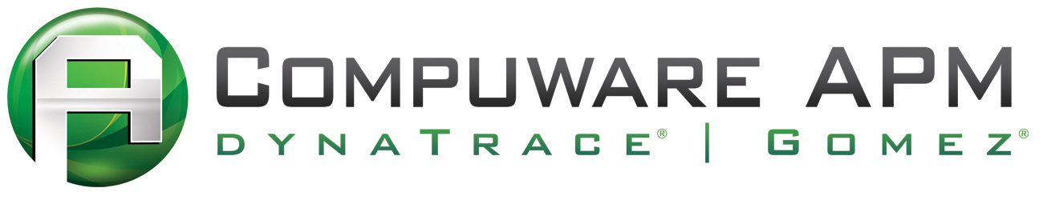
Why Did We Choose dynaTrace?
  PurePath provides DEEP diagnostics
  Robust data visualization
  Business transaction-centric
  Multi-dimensional drill down
  Extremely low overhead
  <1% overhead in production, even during an 1,800% traffic spike
  Automatic application discovery & mapping
  Quick time-to-value
  Collaboration across lifecycle
  Powerful UEM
Notes:
Self explanatory

Slide 11

Our Secret to APM Success
Think differently
Insight, not information
The end-user is King!
From browser to backend
Advocate and empower
Become predictive
Best of breed is OK
APM
http://www.drawinghowtodraw.com/stepbystepdrawinglessons/wp-content/uploads/2011/01/400x400-ninja.png
Notes:
Think different - To quote Albert Einstein “We cannot solve our problems with the same thinking we used when we created them” this actually describes the paradigm shift happening in the APM industry and movement to modern flexible solutions such as Compuware/Dynatrace. We now demand quick time-to-value from all of the new software products we evaluate and adopt.
Focus on insight, not information – Collecting and reporting on thousands of datapoints/events without business application context is a recipe for disaster and results in a low level of APM maturity.
User experience has become of paramount importance
its no longer a nice to have but a must have – the end user is KING!
If someone has a bad experience on your site – they are going to put it on facebook, twitter, consumer reviews, everywhere and anywhere that gives them exposure and a forum to vent their frustrations and things light up light up like wild fire
If consumers feel you are listening to them in terms of delivering features, functionality and performance they will become brand advocates….which positively impact your business and online reputation.
From Browser to backend – While it was critical and necessary for us to uncover and remediate fundamental server-side bottlenecks going into Super Bowl XLVI that Dave will review in detail….we quickly reaffirmed that the importance of focusing on the entire “Application Delivery Chain” to quote Steve Tack from Compuware – from the end-user browser to the back-end datasource.
Advocate & Empower – It’s difficult to drive transformational change in isolation….you truly need to rally around tools such as Dynatrace that enable DevOps like collaboration……quickly developers and admins alike feel empowered to effectively leverage the tools in there everyday duties accelerating velocity and quality.
Become Predictive – we are now getting to the point that we have discovered and can describe the events that lead up to a certain type of outages with almost scientific accuracy…..We feed this into dashboard visualization and alerting – enabling us to resolve issues before the occur and impact our business.
Best of breed is OK – We take the position that best of breed trumps the “monolithic single vendor approach”. From Dynatrace, to Splunk, to Solarwinds to yslow, etc..….we use a variety of tools for a variety of tasks…..overlap is ok as long as you have a definitive source of truth.

Slide 12
dynaTrace Super Bowl Deployment
Notes:
We started with vendor selection, distributed our “mini” RFI and developed our POC test cases/success criteria
We began our POC in late Oct - deploying into a portion of our staging environment.
It took less than a day to install the dynaTrace framework, and the rest of the time was spent instrumenting JVMs and exploring the various
features of Dynatrace. We noticed the differnce right away and were
Moving onto our Production Deployment. We were able to install the dynatrace infrastructure in production, do basic configurations, instrument production jvms as well as the remaining jvms in our lower environments in a week for a total close to 500+ jvms.
I’d also like to mention that the deployment was completed with in house resources who by no means could be considered dynatrace experts at the time with a little help from our friends at dynaTrace who were very kind to help me whenever I had questions in terms of best practices. Also throughout this deployment we were learning new details about our production environment every day. It was very cool process where we would instrument jvms, look at the data, and be able to make immediate recommendations to improve our environment even before the entire deployment was complete.

Slide 13
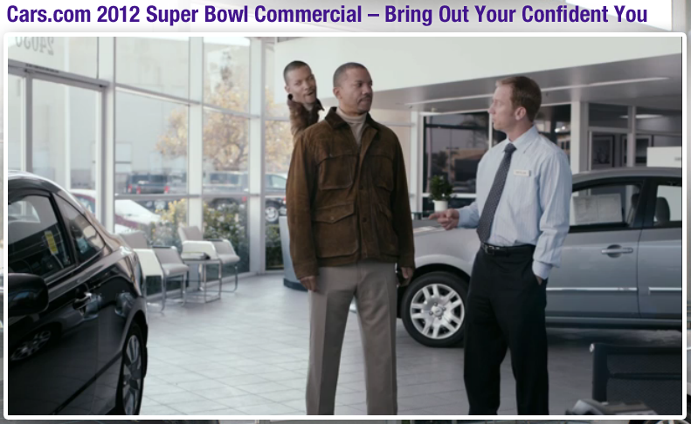
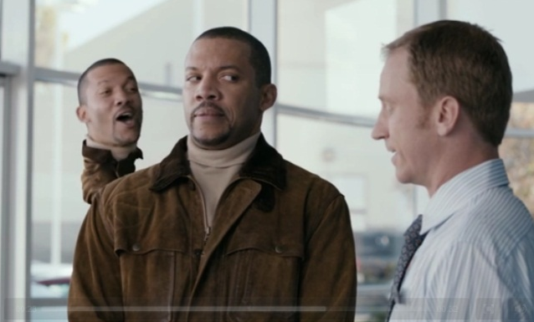
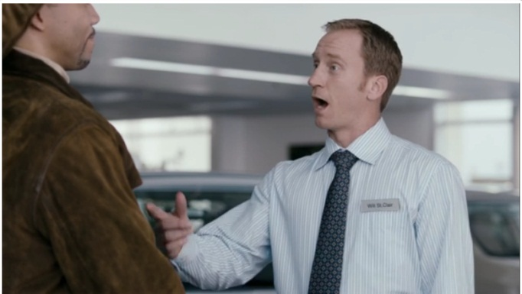


Cars.com Super Bowl XLVI Commercial
Woooo!
13
Notes:
2012 marked our 5th consecutive appearance on the Super Bowl
This year, Cars.com promoted our “Confidence Comes Standard” message in a brand new format to 111 Million viewers
Don’t worry – we thought the SNAKE HEAD MAN was creepy as well! But he got the job done!
Our Dealer customers like to live vicariously through us especially since they get to be affiliated with a company that has such a prominent Ad spot in the Super Bowl
Not only were our dealer customers betting on the success of our Super Bowl Ad… so were our senior leaders…
And if our leaders aren’t confident with our site performance, how could we deliver our “Confidence Comes Standard” message?
That brings me into Case Study 1…

Slide 14
Case Study 1 – Super Bowl XLVI
Problem
Statement
Business
Impact
Ongoing intermittent performance issues
Expecting huge onslaught of traffic
Millions $ marketing spend
111 Million Viewers
Need we say more?
Notes:
CASE STUDY 1 – SUPER BOWL 46
Weeks before the Super Bowl, we had daily intermittent performance issues
We had some theories on where these issues were coming from, but we had no proof
All we knew is that they happened during peak traffic periods
And if we had trouble handling daily peak traffic, how could we survive a huge onslaught of traffic as a result of our Super Bowl commercial

Slide 15
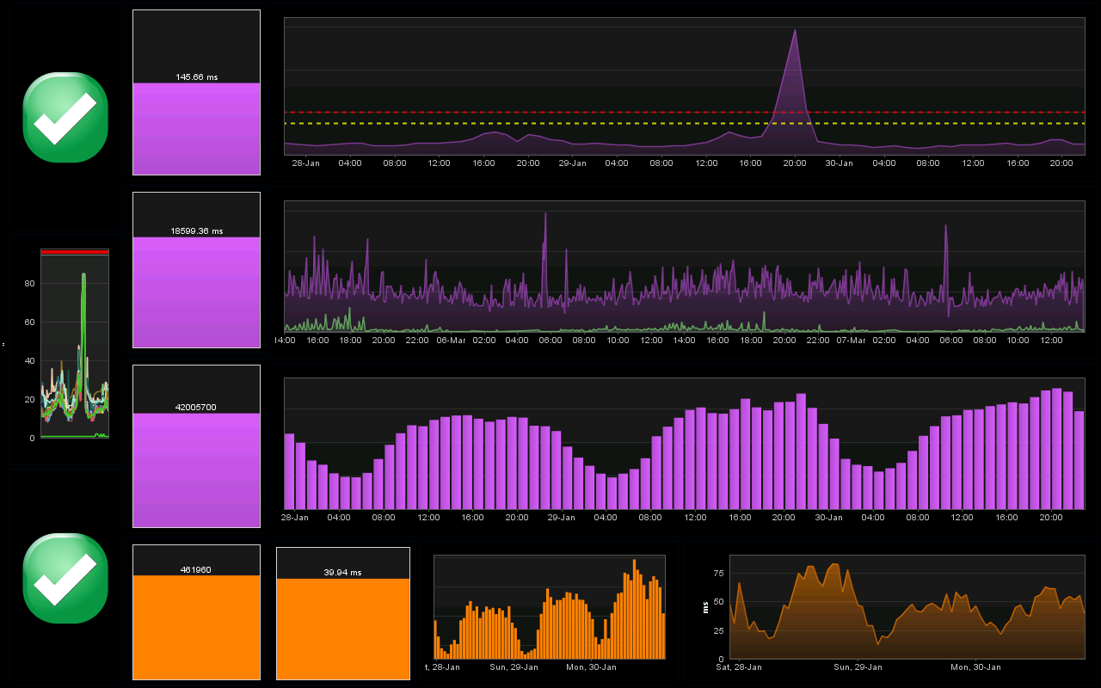
Pre-Super Bowl Performance Issues
We were experiencing nightly response time spikes
And discovered web container thread saturation
During periods of daily peak
traffic…
Notes:
PRE-SUPER BOWL PERFORMANCE ISSUES
We put this dashboard together in less than an hour.
It’s showing key statistics surrounding our search application that we thought might be important for our pre-Super Bowl tuning exercise
We started with a graph of search results page counts.
From there, we added other metrics such as purepath response time and web container thread counts.
What we saw right away is that our web containers were saturating during the same time as our response time spikes.
We were able to quickly pull together vast amounts of easily consumable data
When we were able to see all this data in one place, it was a really simple task to begin a deeper correlation.
What we learned is that your APM tool HAS TO provide insight by allowing you to visualize any type of data you want and with adequate granularity

Slide 16
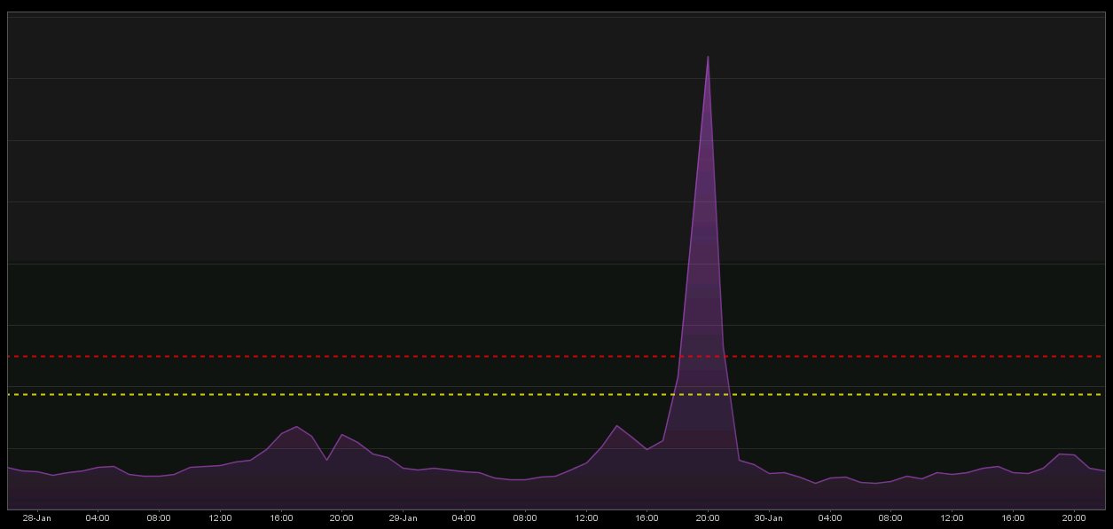
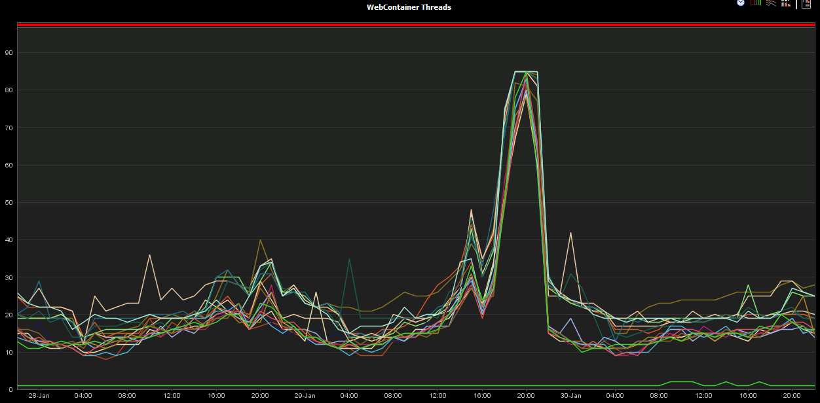
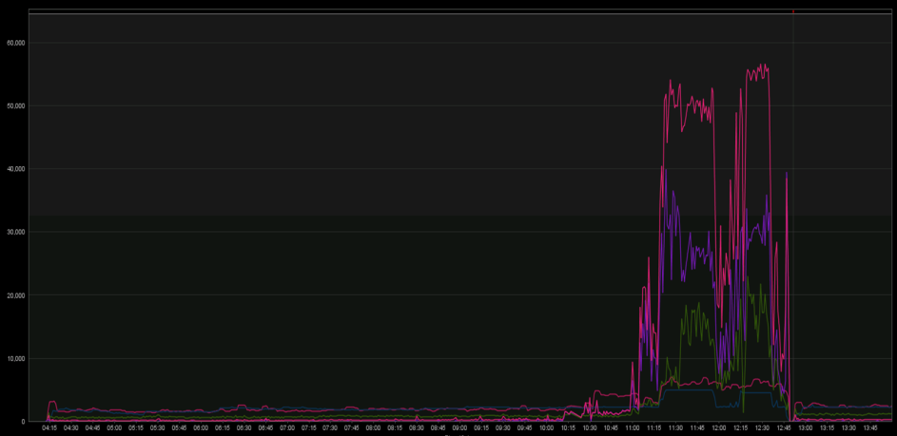
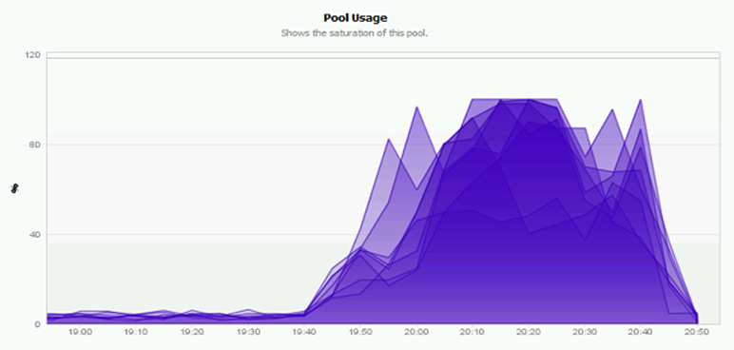
Pre-Super Bowl Performance Issues
Daily
Response
Time Spikes
Web
Container
Saturation
Expensive
Garbage
Collection
JDBC Pool
Saturation
Notes:
PRE-SUPER BOWL PERFORMANCE ISSUES
So beginning with the response time spikes, we correlated that to Web Container Saturation
We found entire tiers of JVMs suffering LONG Garbage Collection events, some of them taking 300 seconds or more to complete, That’s 5 minutes where the JVMs aren’t doing anything!
Then we found that JDBC Connection Pools were saturating, and staying that way for 20 minutes or more
We were privy to all the symptoms, but we still didn’t know the root cause
That is, until we looked at PurePaths …

Slide 17
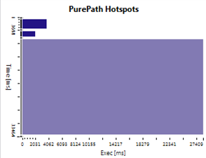
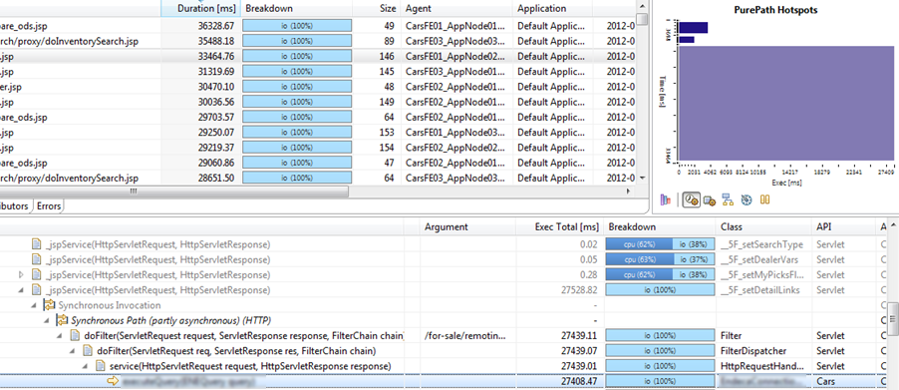

Search Application PurePath Example
http://apublicdefender.com/wp-content/uploads/2008/08/burglar.jpg
Notes:
SEARCH APPLICATION PUREPATH EXAMPLE
What you see here is a single PurePath from our search application. [EXPLAIN PUREPATH]
We got to this detail by right-clicking the response time spike, then drilled down to PurePaths
Please note the light blue bar
Clicking on the largest bar in that section of the screen takes you down to method level detail
That’s when we had our “AH HAH” moment
Within 5 minutes after looking at the PurePaths, we found the root cause
So, let me step through our Ahh-Hah moment –
The method I highlighted belongs to our search appliance, and it was taking 3000% longer than normal
This was caused by queueing in the accelerator
The queuing cascaded into JDBC connection pool exhaustion
Then quickly cascaded into web container thread saturation and even web server connection saturation
DynaTrace enabled us to identify and remediate most, if not all, performance bottlenecks related to our search accelerator with minimal resource effort and cost
Furthermore, we were able to tune all of our high-throughput services which we identified via the Business Transaction PurePath counts
??? I might sound like a dynaTrace cheerleader here, but all kidding aside, it literally takes 1-3 clicks to get to some sort of a root cause.

Slide 18



New Dual-Data Center Configuration
Stage
Accelerators
Prod
Accelerators
Stage Web
Prod Web
Staging Data Center
Production Data Center
VIPs
WS8
WS7
WS1
WS2
WS7
WS8
WS10
WS9
WS3
WS4
WS9
WS10
C1
C2
C1
C2
C3
C4
Search
Frontend
Services
Search
Frontend
Services
Search
Frontend
Services
Search
Frontend
Services
Search
Frontend
Services
Search
Frontend
Services
18
8 Search Accelerators
10 Search Accelerators
Database
Database
WAN
Notes:
NEW DUAL DATA CENTER CONFIGURATION
In the past
The answer to super bowl preparation was to buy more hardware, configure & deploy it as capacity for the game
Then repurpose the hardware either into production, or our lower test environments a few weeks later
It was the “EASIEST” and the most “EXPENSIVE" thing to do
This year we took a vastly different approach:
We were able to repurpose our Staging/DR/performance test environment and configure it as a second data center
Only with dynaTrace could we address some of the fundamental bottlenecks that were preventing us from using the Staging and Production environments in a dual-datacenter active/active configuration for previous Super Bowl campaigns.

Slide 19
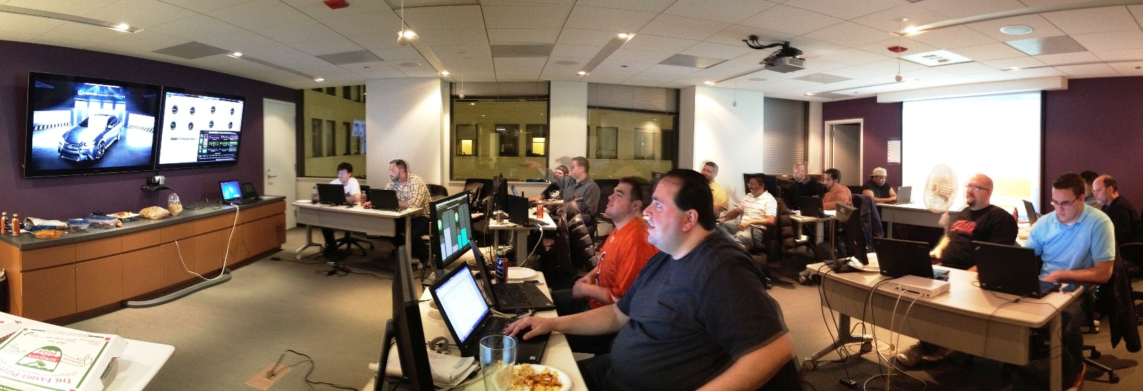

Cars.com Super Bowl War Room
Super Bowl
XLVI
dynaTrace Dashboards
Jim Houska
Pizza
David Beran “Photographer”
Wings
Beer
Notes:
CARS.COM SUPER BOWL WAR ROOM
This was our Super Bowl 46 War Room
We figured if we’re working during Sunday’s big game, we could treat ourselves to some pizza, some chicken wings, and a few beers. And, of course, we were able to watch the game on the big screen
But we had a job to do, so we wired up the room with power strips and Ethernet hubs… it was kind of reminiscent of Quake or Unreal Tournament LAN Parties we went to 15 years back
In the past,
being in this room was extremely stressful
We were constantly firefighting
We would even take precautionary measures, going so far as to restart our web servers to prevent connection exhaustion
This year was totally different
We had CONFIDENCE going into super bowl that we remediated all of our bottlenecks
We had REAL TIME DATA showing us that our applications were healthy during the game
It turned out to be a NON EVENT
SO Much So, we might not even need an on-site presence next year

Slide 20
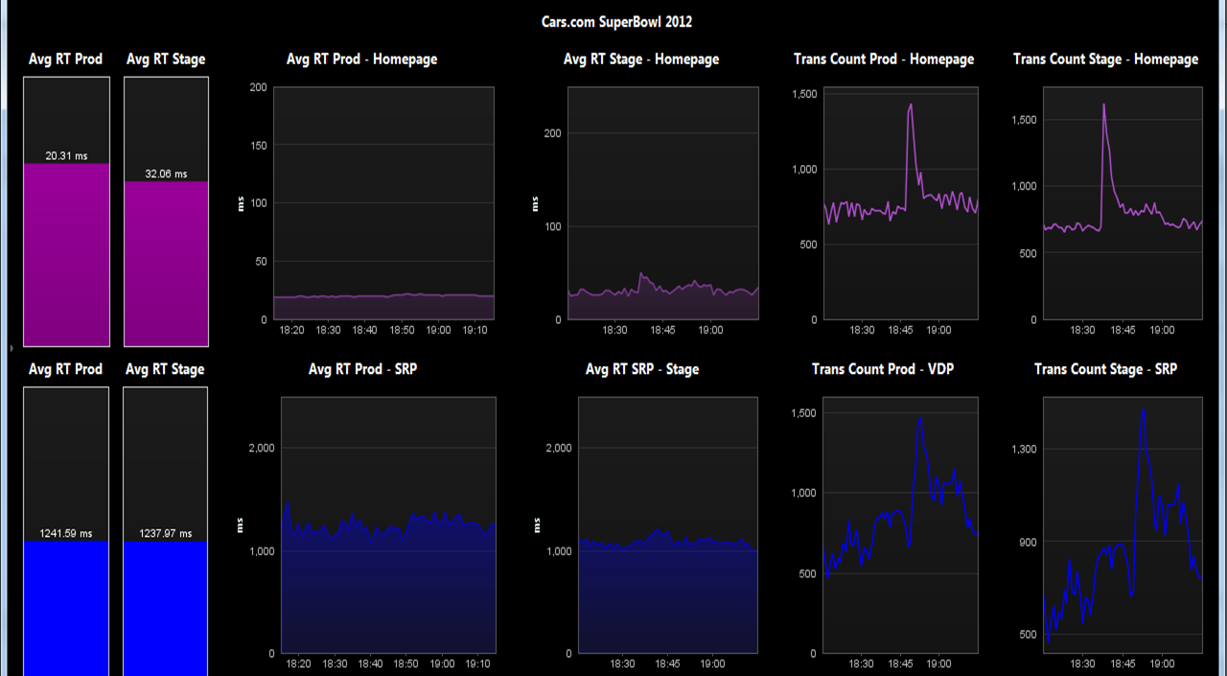
Performance During Super Bowl
Two Data Centers on One Dashboard!
Data Center 1
Data Center 2
Notes:
PERFORMANCE DURING SUPER BOWL
Here’s a dashboard Jim created 15 minutes into the Super Bowl
It’s pulling data from two different dynaTrace servers, allowing us to visualize both data centers on a single pane of glass
I’m happy to say we were able to sustain an 1800% spike in traffic while maintaining flat response times
Let me show you this full-screen...
??? The ability to visualize any data from any data source is one of my favorite features of dynaTrace, and is key to fast, accurate correlation

Slide 21



Super Bowl-Sized Test
1,800%
Traffic Spike
Stable Performance
Commercial Airs
Notes:
SUPER BOWL SIZED TEST
We stood up to the challenge – we passed a Super Bowl test with flying colors
Given all the transaction data within dynaTrace, we were able to quickly turn around metrics to our senior leadership team within the hour

Slide 22
Case Study 2 – Lead Generation
Problem
Statement
Business
Impact
Agile release triggered a loss of email leads
No application errors were generated
Developers pulling their hair out
SIY Consumers and 17,000 dealers
Potential revenue loss of $200,000
Notes:
CASE STUDY 2 – LEAD GENERATION
A major part of our business is sending consumer vehicle leads to our dealer customers
One of our Agile releases triggered an intermittent loss of email leads
The potential revenue impact for this bug was estimated at $200k, impacting consumers and dealers alike
Unfortunately, the problem wasn’t escalated out of the agile product team for almost a week
At the time, The Developers were reliant on traditional methods for finding bugs – i.e. combing through log files
Once I heard about the issue (in a hallway conversation), I asked the developers what dynaTrace said about the issue. They had no answer. I showed them the PurePaths and found the root cause in less than two minutes.

Slide 23
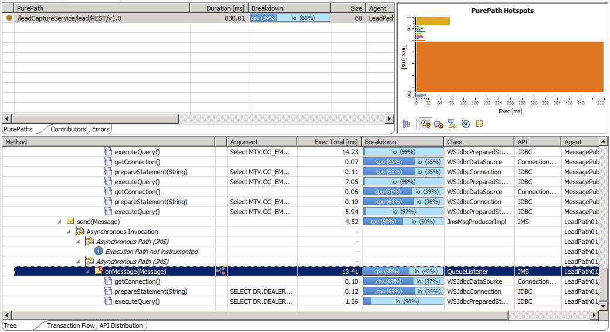
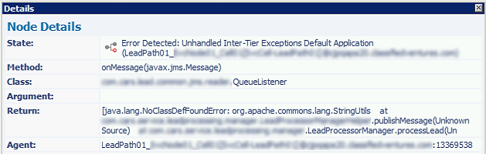

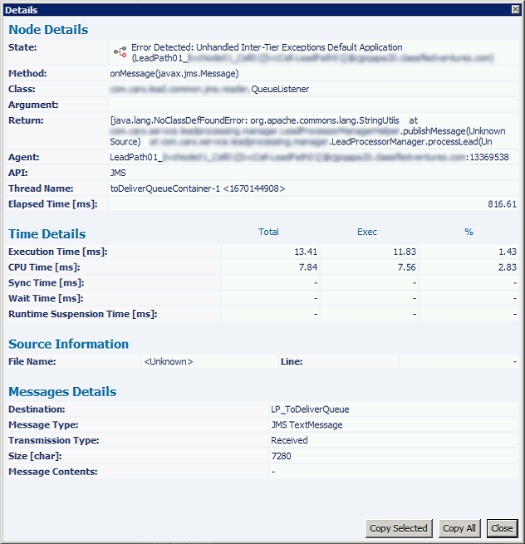
Production LeadPath Issue
Notes:
These are the same exact screens I pulled up for the developers…
[WALKTHROUGH EXAMPLE]
In the end, we were able to fix the Lead Path code defect. We also used Splunk to recover all the lost leads and our revenue.

Slide 24
Case Study 3 –POC of UEM
Problem
Statement
Business
Impact
Visibility into 3rd party calls or CDNs
Visibility into client-side performance
Lack of network time or bandwidth metrics
Tolerating or Frustrated consumers may abandon Cars.com
Page views = $$$ ← This is our Bottom Line
Notes:
We’ve had a non-centralized, ad-hoc, narrow view into client-side performance
We’re able to see on-browser performance using tools you've all likely used yourselves - dynaTrace AJAX, HTTPWatch, FireBug, Yslow, Chrome Page Auditor via the JavaScript Console, and more - Name it, I've used it
I’m still lacking a view into end-user performance for real users
Synthetic monitoring only gets you minimal information
As you know, the world works different for real users
Most Real users ...
aren't connected at corporate Internet speeds
don't live within 30 miles of our data center, think" latency"
And most importantly, they may have resource-consuming browser toolbars, outdated Java, browser, or OS versions, or even malware which may cause lengthy JavaScript execution and rendering activities, not to mention browser errors. This would degrade their user experience - and even though the problem might be on their end, they're still gonna blame us for slow page loads.
As such, I'm really interested in what UEM had to offer us since it extends our entry point in dynaTrace from our JVMs to the real user's browser
I want to mention we’re still not done with our POC, we’ll get back at it when we get back to Chicago
??? We’ve never had a transaction-rich, holistic, detailed view from browser to backend via PurePath

Slide 25
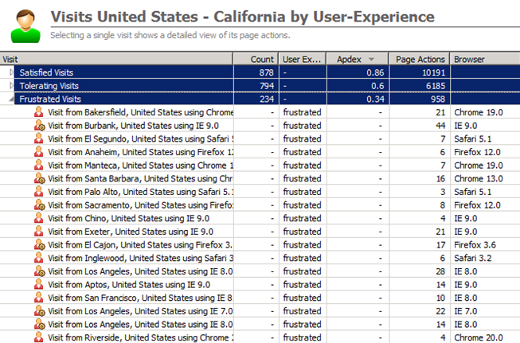
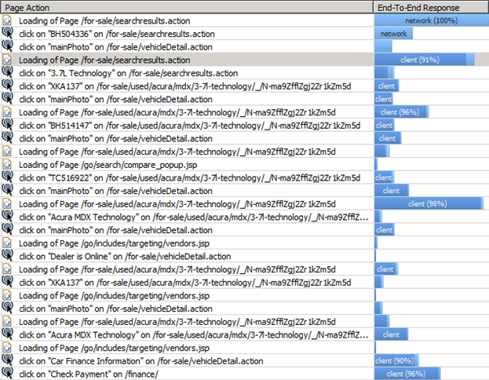
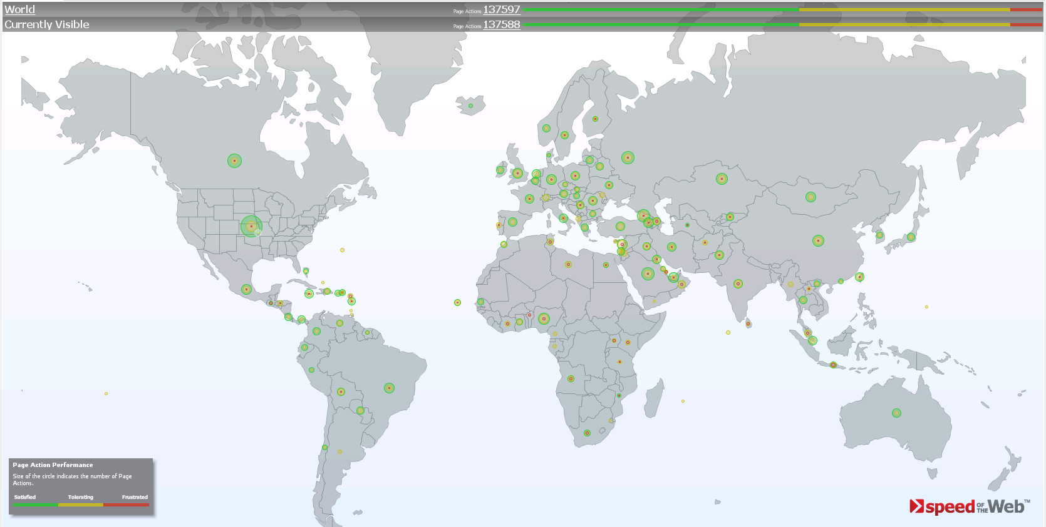
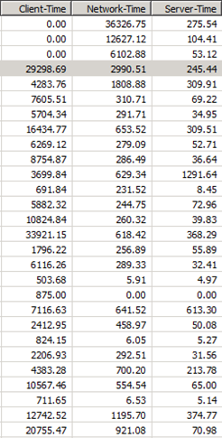
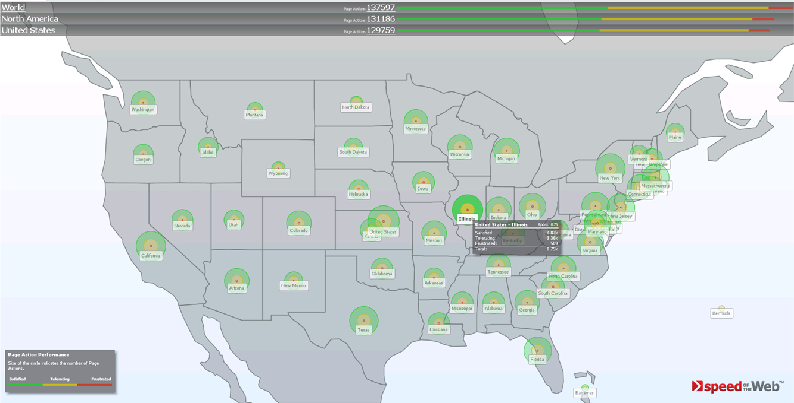
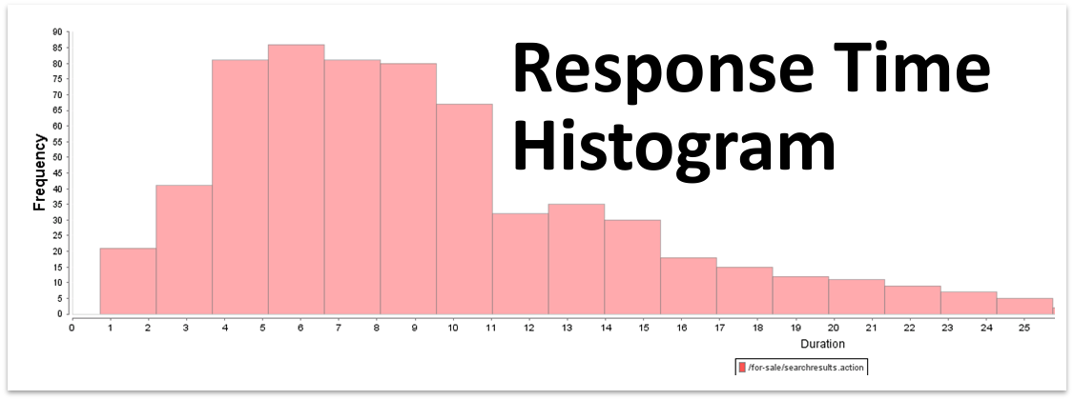
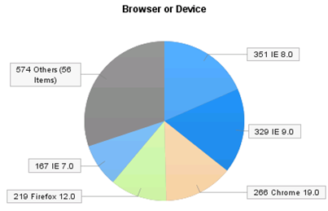
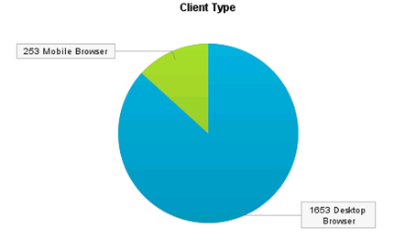
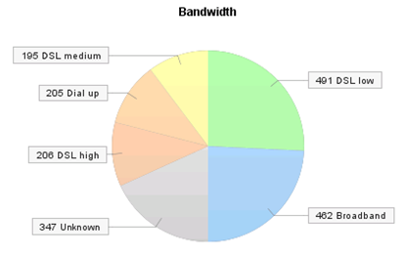
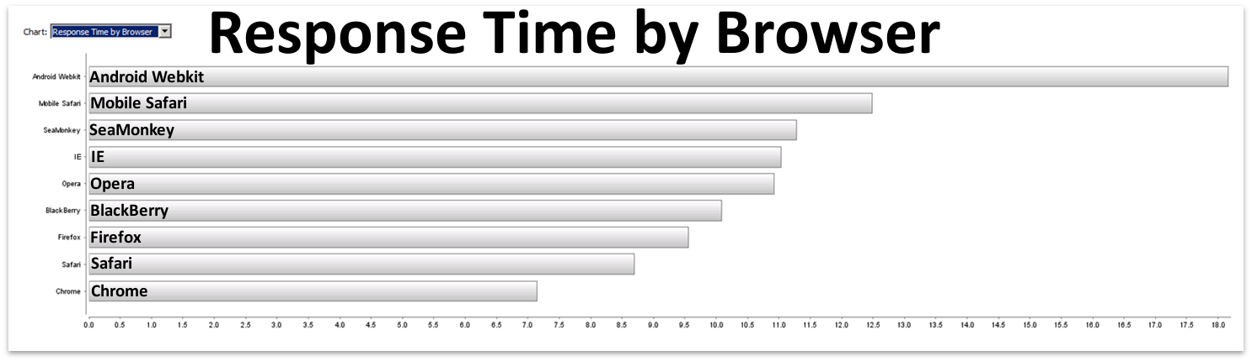
POC of dynaTrace UEM
Notes:
Also an analytics engine

Slide 26
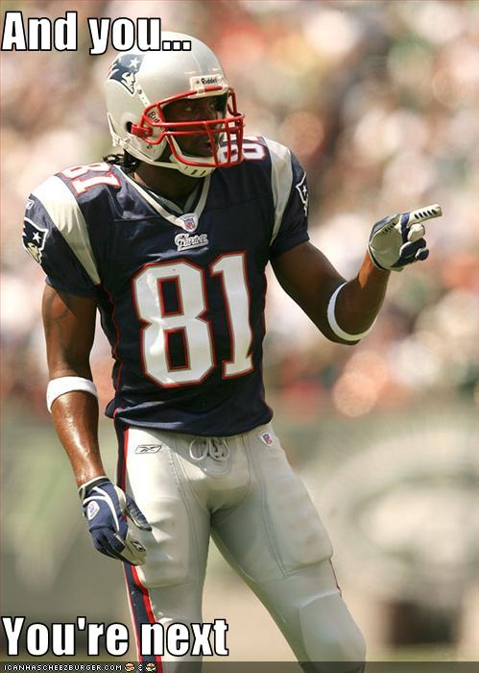
What’s Next?
Top 10 Targeted Client-Side Improvements for Cars.com
Make Fewer HTTP Requests
Reduce the Number of DOM Elements
Reduce DNS Lookups
Add Expire Headers
Configure Entity Tags (Etags)
Put JavaScript at the Bottom
Compress Components with GZIP
Avoid URL Redirects
Minify JavaScript and CSS
Effective use of a CDN
http://cheezburger.com/2689591040
Notes:
So based on our 45 minutes playing with UEM, and doing further traces with other on-browser performance tools, I’ve compiled a targeted top 10 list of client side performance improvements:
My favorites are
#1 – Make fewer HTTP requests –
I’ll be the first one to say it… Cars.com pages are heavy.
Most of the pages on our site have upwards of 160 elements.
[MAYBE ASK AUDIENCE] Industry average number of page elements for 2012 is around 70 elements.
#2 – Reduce the number of DOM elements
Yahoo says highly dynamic, complex pages, such as the Yahoo homepage, should have no more than 700 DOM elements to maintain consistent browser performance across various browser types and versions.
I've found some of our pages have as many as 3300 DOM elements
#3 – Reduce DNS lookups –
We had around 18.3 million unique visitors and roughly 200 million page views this May
a lot of those users were new to our site and landed with a cold cache.
DNS lookups are expensive..
A good rule of thumb regarding DNS Lookups is to expect about 0.1 seconds per lookup.
One of our pages sources elements from 52 unique domains!
that’s 5.2 seconds wasted!
Before I hand it back to Jim, i'd like to thank you for listening to uur story. Jim is going to talk to you about what’s next for us in terms of APM.

Slide 27
What Else?
DynaTrace 4.2 Upgrade
  Smart Monitoring, Workflow, & Detection
  Self Learning; Intelligent Auto-Baselining
  Zero-Configuration System Health Monitoring
  Faster Production Analytics – 100X
  Native Mobile UEM
Client / Browser-side Optimization
  POC of Google Page-Speed
  Top 10 Client-Side Improvements
Notes:
3. Smart Baselining That's Self-learning
Tired of Yet-Another-Baselining-Based-On-Averages? We certainly are. YABBOA is only good on paper. dynaTrace provides fully dynamic, self-learning and problem-specific baselines to automatically detect abnormalities of
response times
transaction failure rates
throughput
system health.
This next-generation approach makes alerting more precise, provides alerts earlier in high- and low-load scenarios and reduces false-positives by 90 percent.
Do you need to know the user experience of your customers using native applications on their Android and iOS devices? dynaTrace UEM now comes with am obile Agent Development Kit (ADK), which provides end-to-end visibility from the mobile phone down to the database call. Understand the impact of every back-end call on the user experience and find out which device types are struggling using your applications.

Slide 28
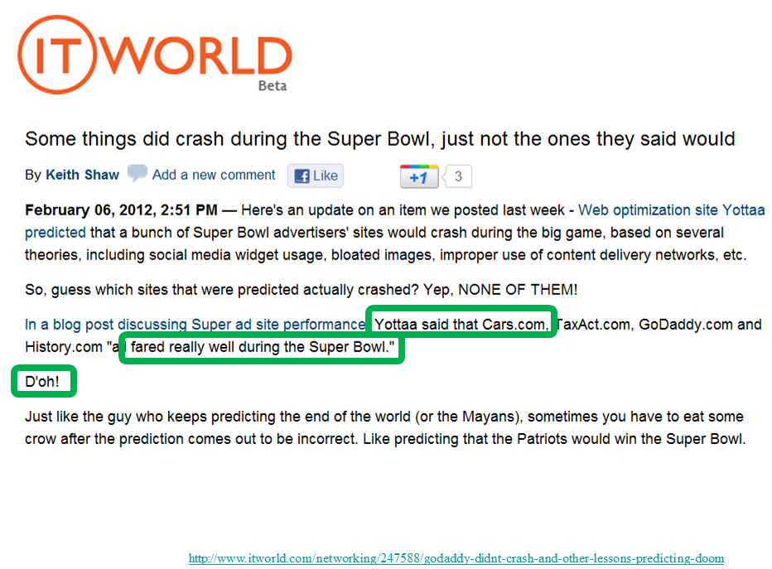

IT World / Yottaa Prediction… “D’oh!”
IT World & Yottaa said that Cars.com actually “…fared really well during the Super Bowl.”
“ ”
http://www.smtexas.net/faculty/jackson/CAPPS61011/CAPPS6T2I/Reddy/Webpage/D'oh.html
Notes:
After the superbowl Yottaa actually said that Cars.com fared really well during the super bowl. The end result was a lot of happy folks and mucho kudos from our senior leadership team.

Slide 29
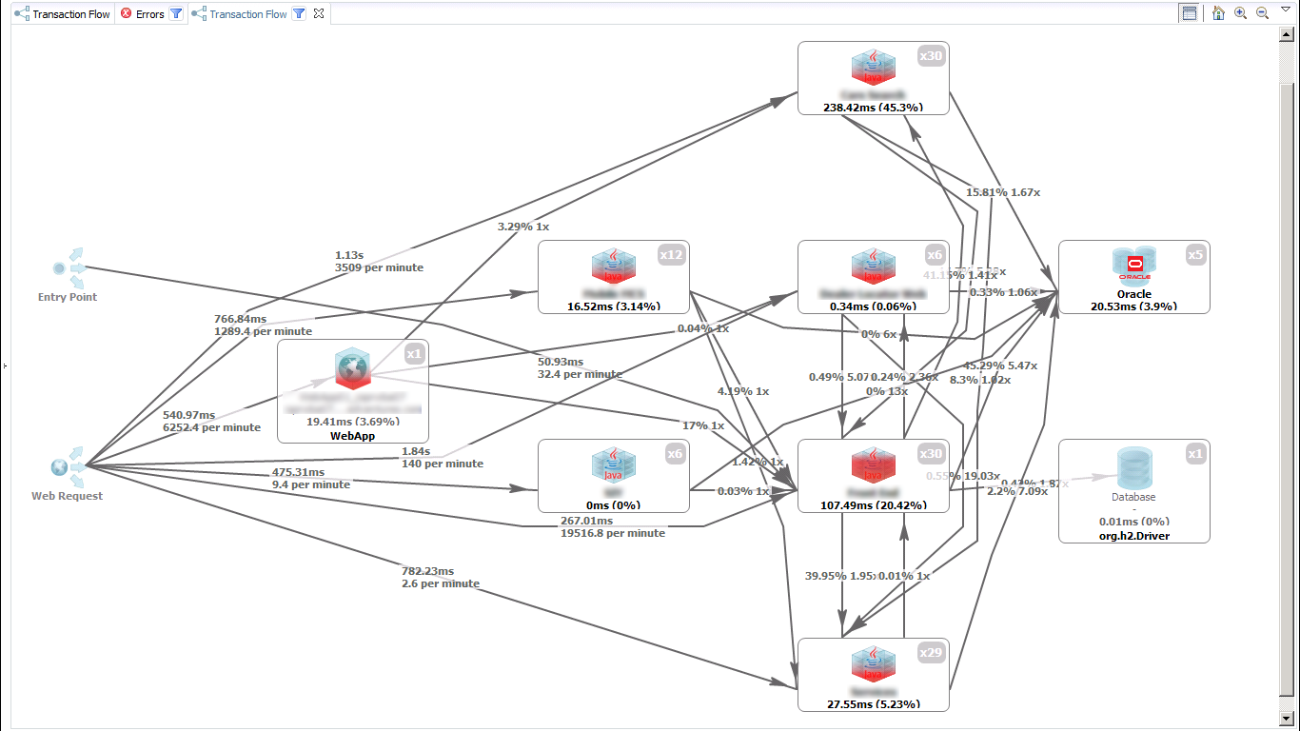
Transaction Flow Topology

Slide 30
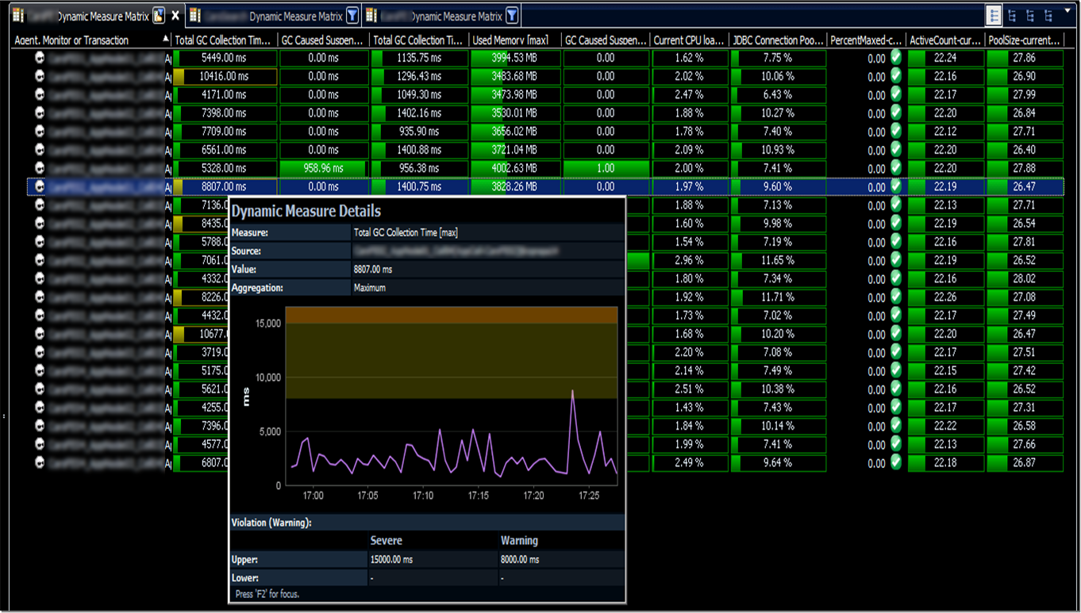
Dynamic Measure Matrix

Slide 31
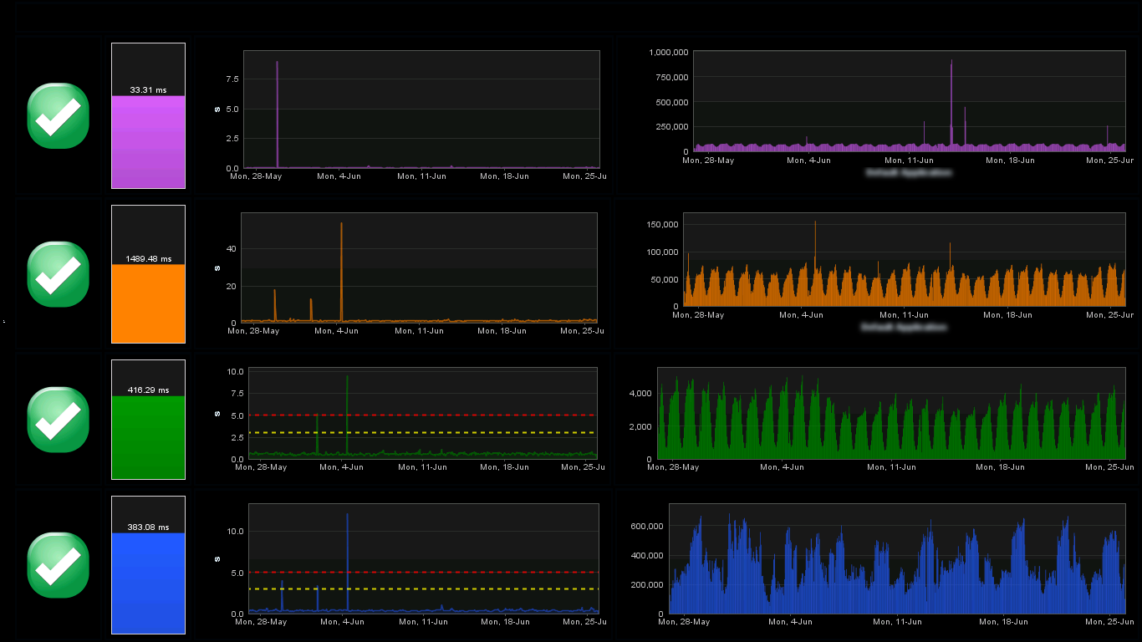
Dashboard Examples

Slide 32
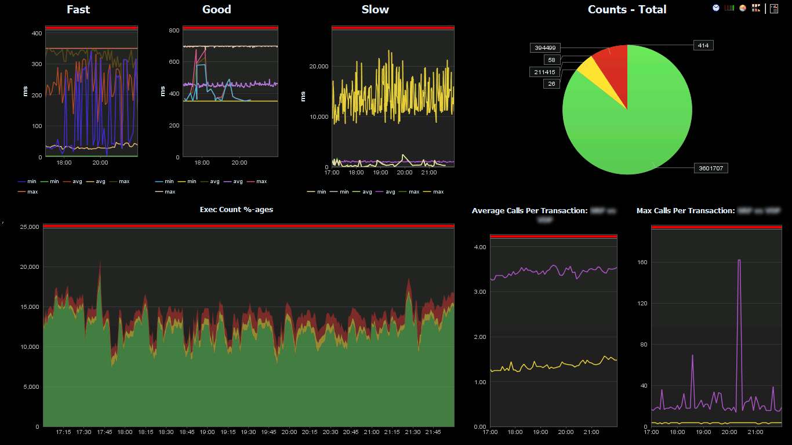
“Fast / Good / Slow” Dashboard

Slide 33
Questions?
?

